Slide 1

R1 – Research Presentation
Burnout syndrome among all French general practitioner trainees. A 2011 cross-sectional study of 4,050 questionnaires (E. Galam, A. Le Tourneur, V. Komly)
The MyHealthCheckUp Challenge: Optimizing wellness for medical students, medical residents and attending physicians (C. Holly, R. Montoro, N. Gupta, S. Lemieux, I. Lowensteyn, D. DaCosta, S. Grover)
Mindful communication as a facet of continuing education
(A. Chakravarti, C. Garcia)
Ville-Marie, Friday, Oct. 26, 2012 (2:45 pm-5:15 pm)

Slide 2

Burnout Syndrome Amongst All French General Practitioners in training
A 2011 Cross Sectional Study of 4050 questionnaires
Eric GALAM (*)
Valériane KOMLY Antoine Le TOURNEUR
(*) eric.galam@univ-paris-diderot.fr
2012 AMA-CMA–BMA International Conference on Physician Health 2012 Montreal, Quebec, Canada, October 25-27

Slide 3
Burnout Syndrome : complex work-related syndrome
3 components
- Emotional exhaustion (EE) : intense emotional tiredness
- Depersonalization (DP) : negative and cynical attitude against patients
- Low personal accomplishment (PA) : demotivation, loss of self-confidence and self-depreciation in relation with work
It can be assessed by Maslach Burnout Inventory (MBI)
Repercussions
Care : quality of care, medical errors
Carers : serenity of the carers, doctor’s suicide
Health care system : reduce number of practicing doctors in France
(delayed beginning of professional life, early retirement, abandon profession)

Slide 4
THE STUDY
Objectives: to assess
1) Burnout among all French General Practitioners in training (GPTs)
2) Associated factors
3) consequences on their professional and private lives
4) To appreciate GPTs’ acceptance of prevention and management proposals
Design:
- Descriptive, epidemiological, transversal study
- All 6309 French GPTs attending a meeting to choose their next six month placement (march 2011)
- Written questionnaire including MBI and items about their health and how they felt about medical internship

Slide 5
EGPRN study (2008) (*)
EE : 43%; DP: 35%; reduced PA : 32%
65% : one high score 12% : 3 high scores
Truchot’s (**) studies in 3 French regions (2001, 2002, 2003) : EE : 43%; DP : 40%; low PA : 33%
Parisian Regional Union of Ambulatory Practitioners study (not using MBI) 2007 (***)
60,8% of GPs felt threatened by burnout
(*) Soler JK, Yaman H, Esteva M, Dobbs F, Asenova RS, Katic M, et al. Burnout in European family doctors: the EGPRN study. Fam Pract. 2008 août;25(4):245-65
(**) Truchot Didier (2004). Epuisement professionnel et burnout Dunod
(***) Galam E, Mouriès R. L’épuisement professionnel des médecins libéraux franciliens: Témoignages, analyses et perspectives. URML IDF/ Commission prévention et santé publique; 2007

Slide 6
GENERAL PRACTITIONERS IN TRAINING (GPTs)
Sudden acquisition of responsibility patient care
Competitiveness
fear to show vulnerability or to be stigmatised
Constraining duty times
Scientific work (thesis, dissertations …).
Family distance, frequent moves

Slide 7
RESULTS : POPULATION
4050 questionnaires exploitable/ 6349 asked
Average age : 26,4 years
men : 31 %
working place : 18% (A&E) , 16% (pediatrics or gynecology), 27% (internal medicine),
24% ( private GP practices) 15% (free choice)
40% : 1st year; 34% : 2nd year; 26% : 3rd year
Representative of the population of GPT (Nov 2010)

Slide 8
RESULTS
Response rate : 64.2%
From 33% (in Bordeaux) to 90% (in Limoges)
High EE: 16%
High DP: 33.8%
High PA (low personal accomplishment): 38.9%
No high score : 42%
Three high scores : 7%

Slide 9
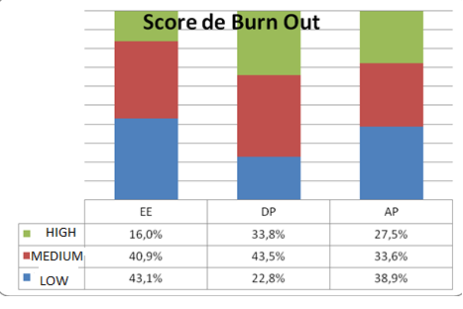
Burnout Syndrom Results of each score
58% : 1 high score
24% : 2 high scores
7% : 3 high scores
Average Score EE : 20,0 E-T 9,36
Average Score DP : 9,7 E-T 5,17
Average Score low PA : 34,8 E-T 6,96

Slide 10
Whole France Total numbers of responders : 4050 | Percentages
Feel threatened by burnout | 46.9
Married or couple/single | 65.2
Child > 0 | 8.8
Average hours worked per week | 48.94
≥ 50 h / week | 53
Nights on call per month ≥ 3 | 49.3
Number of free weekends per month ≤ 2 | 55.1
Number of weeks of holidays during current 6 month course ≤ 2 | 81.2
Devote sufficient time to family and friends | 47.3
Practice regularly a leisure | 41.4
Residency : obstacle to having children | 55.1
General practice chosen by choice | 74.9
Will enroll again in medical studies | 63.6
Think of dropping out of medical school often / regularly | 16.7
Feel threatened by burnout | 46.5
Drink more than 3 glasses of alcohol > 1 / week | 5.4
Sleeping pills ≥ 1 / month | 9.2
Have been taking antidepressants during residency | 6.5
Had to get psychological or psychiatric therapy during residency | 12.1
Had suicidal ideas during last 12 months | 6.1
Had tried to commit suicide | 1.4
Fear to make a medical error : often/every day | 53
Worry about patients out of professional context : often/every day | 29.6
feeling that the senior doctor were “dissatisfied” (often) | 34.8
Enough recognition from seniors | 64.9
Enough recognition from medical team | 74.3
Enough recognition from patients | 79.3
Feeling well accompanied | 55.8
Feeling well recognized (social position, salary, workload) | 21.5

Slide 11
NUMBERS OF HIGH SCORES/WORKING PLACE
 | Emergency | Internal Medicine | Free choice working place | Pédiatry or Gynecology | Private Practice second level | Private Practice first level
High EE | 19.8% | 16,5% | 15,4% | 16% | 14,7% | 12,2%
High DP | 42,3% | 32% | 31,8% | 37,3% | 27,6% | 28,3%
Low PA | 41% | 41% | 37,6% | 38,5% | 34,6% | 36,1%
0 high score | 34,4% | 42,4% | 44,7% | 40,4% | 46,7% | 45,8%
1 high score | 35,6% | 33,5% | 33,2% | 34,2% | 32,2% | 36,4%
2 high scores | 21,6% | 17,3% | 16,1% | 18,8% | 15,8% | 13,3%
3 high scores | 8,5% | 6,8% | 5,9% | 6,7% | 5,3% | 4,5%

Slide 12
 |  | 0 | 1 | 2 | 3 | p
France |  | 41,9% | 58,3% | 24,1% | 6,5%
Feel threatened by burnout | No | 65.5 | 53.7 | 35.6 | 15.8 | <0,001
 | Yes | 34.5 | 46.3 | 64.4 | 84.2
Gender | Female | 44,3% | 34,0% | 15,8% | 5,8% | <0,001
 | Male | 36,7% | 34,8% | 20,6% | 7,8%
Six-month period in progress: | Private practice | 45,9% | 35,7% | 13,7% | 4,7% | <0,001
 | Hospital | 39,7% | 34,0% | 19,0% | 7,3%
Average hours worked per week | Average | 47,17 | 48,72 | 51,67 | 54,78 | <0,001
Number of nights on call per month | 0 | 48,6% | 33,2% | 13,6% | 4,5% | <0,001
 | 1 | 42,7% | 35,6% | 15,9% | 5,8%
 | 2 | 39,4% | 35,8% | 18,3% | 6,5%
 | 3 | 39,0% | 33,4% | 20,7% | 6,8%
 | 4 | 39,0% | 35,8% | 17,6% | 7,5%
 | 5 | 39,7% | 37,2% | 14,9% | 8,3%
 | 6 | 44,1% | 25,7% | 20,6% | 9,6%
 | 7 | 37,9% | 36,1% | 18,9% | 7,1%
Number of free weekends per month | 0 | 37,1% | 38,7% | 17,7% | 6,5% | 0,001<
 | 1 | 30,5% | 33,8% | 22,6% | 13,1%
 | 2 | 38,3% | 35,7% | 18,7% | 7,4%
 | 3 | 46,6% | 33,0% | 16,4% | 4,0%
 | 4 | 49,8% | 32,9% | 13,4% | 4,0%
Devote sufficient time to family and friends | Do not agree | 35,3% | 33,0% | 21,7% | 10,0% | <0,001
 | Agree | 49,2% | 35,8% | 12,5% | 2,5%
Practice regularly a leisure | Do not agree | 37,9% | 34,2% | 19,2% | 8,7% | <0,001
 | Agree | 47,7% | 34,3% | 14,6% | 3,3%
Residency : obstacle to having children | N | 49,2% | 34,8% | 12,7% | 3,3% | <0,001
 | Y | 36,3% | 33,2% | 21,6% | 8,9%
General practice chosen by choice | Y | 44,1% | 34,2% | 16,2% | 5,5% | <0,001
 | N | 35,3% | 34,6% | 20,8% | 9,3%
Regret having chosen medicine | N | 36,3% | 33,3% | 20,7% | 9,8% | <0,001
CORRE
LATIONS
(1)

Slide 13
Fear to make a medical error : | Never Seldom Sometimes | 49,2% | 33,4% | 13,3% | 4,1% | <0,001
 | often/every day | 35,6% | 35,1% | 20,8% | 8,5%
Think you could make medical errors | Never Seldom Sometimes | 44,5% | 34,4% | 15,8% | 5,3% | <0,001
 | often/every day | 22,6% | 33,3% | 29,0% | 15,2%
Enough recognition from seniors | N | 33,9% | 33,5% | 21,7% | 10,9% | <0,001
 | Y | 46,1% | 34,8% | 15,0% | 4,1%
Enough recognition from medical team | N | 30,1% | 34,8% | 23,4% | 11,7% | <0,001
 | Y | 45,7% | 34,2% | 15,4% | 4,8%
Enough recognition from patients | N | 26,0% | 35,3% | 26,6% | 12,2% | <0,001
 | Y | 46,0% | 34,1% | 14,9% | 5,1%
Think of dropping out of medical school often / regularly | N | 45,0% | 35,0% | 15,4% | 4,6% | <0,001
 | Y | 26,4% | 30,7% | 27,1% | 15,7%
Drink more than 3 glasses of alcohol > 1 / week | never | 41,0% | 36,7% | 15,5% | 6,8% | <0,001
 | 1 a week | 42,3% | 29,7% | 20,8% | 7,2%
 | more | 27,8% | 38,1% | 22,2% | 11,9%
Have been taking sleeping pills ≥ 1 / month | 1 a week | 30,3% | 26,3% | 25,0% | 18,4% | <0,001
 | more | 15,8% | 26,3% | 29,8% | 28,1%
Have been taking antidepressants during residency | N | 42,3% | 34,5% | 17,0% | 6,2% | 0,01
 | Y | 37,1% | 30,4% | 22,4% | 10,1%
Had to get psychological or psychiatric therapy during residency | N | 42,9% | 34,4% | 16,6% | 6,0% | <0,001
 | Y | 35,0% | 33,0% | 22,3% | 9,8%
Had suicidal ideas during last 12 months | N | 43,1% | 34,2% | 17,1% | 5,6% | <0,001
 | Y | 24,3% | 35,3% | 20,2% | 20,2%
Had tried to commit suicide | N | 42,1% | 34,4% | 17,2% | 6,3% | <0,001
 | Y | 28,0% | 26,0% | 26,0% | 20,0%

Slide 14
55 had already tried to commit suicide
36,4%, regret having started medical studies
16,7% thought giving up their training (often, regularly)
9,2% take hypnotics at least once a month
(5 to 7% of the French general population)
6,5% take or took antidepressants (3,5% of consumers in the French general population above 15 years old and 5% in French GPs)

Slide 15
MAIN ASSOCIATED FACTORS OF BURNOUT
Workload :
47,2 hours weekly ( GPTs who don’t suffer from BOS) against 48,7h (1 high score of burnout), 51,7h (2 high scores) 54,8h (3 high scores)
Working place :
internal medicine and A&E : higher average high scores for EE, DP and lower for PA
private practices in primary care had less average high scores.
Lack of recognition from the senior (++), medical team, patients
Dissatisfaction about time devoted to family and friends and/or leisure:
50% (GPTs free of BOS)
80% (GPTs presenting 3 high scores)
Feeling that the senior doctor were “dissatisfied”
accounted for 61,5%, (3 scores) 45% (2) ,32,6% (1) 28,4% (no high score)

Slide 16
Age higher than 30 years
male sex for DP
No child Having at least a child is statistically related to the fact of being unscathed by burnout
Number of nights on-call
Choosing general practice training as a second choice
Having had consulted a psychotherapist
Suicidal ideas, suicide attempts
Fear to be involved in a medical error
OTHER
ASSO
CIATED
FAC
TORS

Slide 17
RESEARCHERS PROPOSED SOLUTIONS
82.5% of GPTs would agree to reduce workload
70% would like to get a tutor
54.9% would like peer groups
33.8% would like more autonomy
30% would like to get a hot line

Slide 18
DISCUSSION (1)
BOS interests GPTs : response rate 64,2%
BOS is not only an individual problem
BOS is more linked to quality of working conditions than on practice settings or on time
Average scores are similar for all GPTs sudies
EGPRN study with practicing physicians shows higher EE scores, similar DP scores and higher PA
Worthy of further discussion and analysis

Slide 19
DISCUSSION (2)
Difference between GPTs and practicing doctors
Lack of experience
Constraints related to the way the residency is organized
Social evolution of the status of doctor
Medical school which includes hard work, difficult decision making, competition and permanently renewing medical knowledge.

Slide 20
PREVENT BURNOUT
Aim of perfection
Counselling students involved in medical errors
Learning how to speak with patients
Revalue the course in private practice
Better communication with supervisors
Extra-professional lives : status of the pregnant GPTs, reducing workload, taking into account the difficulties of housing

Slide 21

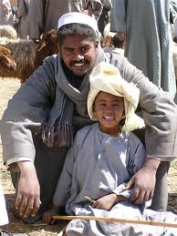
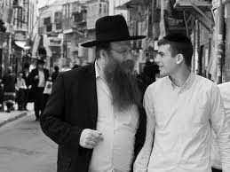
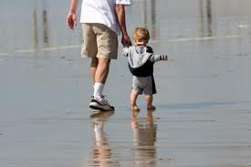
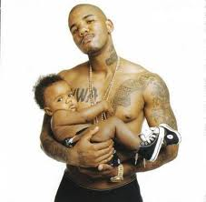
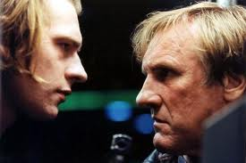
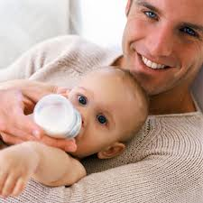
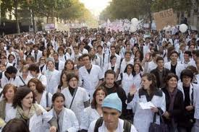
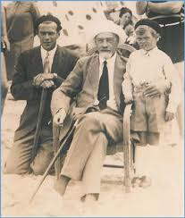
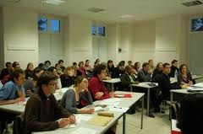

FATHERS AND CHILDREN
GPTs play an important role in french health system
GPTs are GPs of tomorrow

Slide 22


Assessing is the first step

Slide 23

It’s time for action !
Thank you

