Slide 1




Qualitative study :
Obstacles to physical activity in the MTF Transgender population
Gilles de la Londe J, Mignotte K, Aubert JP

Slide 2
Conflicts of interest
none

Slide 3

Definition: Transgender
people who experience dissonance between
sex as assigned at birth
and
gender identity
MTF: Male-to-Female
American Academy of Pediatrics, 1999
Notes:
which is developed in early childhood and understood to be firmly established by age
GENDER IDENTITY= self-identification as woman, man, neither or both

Slide 4
Background
General Practice in Paris, 18th France
High prevalence of HIV positive MTF-TG patients
Prevention of High Cardiovascular Risk
Experiencing difficulties to practice sports
Notes:
My director of thesis who is a GP working in a popular area, speaking spanish and interested in taking care of infectious diseases (HIV, hepatitis)
Which lead to taking care of a LOT OF TRANSGENDERED HIV positive WOMEN and especially from Latin America.
Indeed, estimated HIV infection rates among specific Transgender populations range from 14 to 69% according to several transgender HIV/AIDS needs assessments and sexual risk behavior studies.
The highest prevalence may be among male to female transgender sex workers.

Slide 5
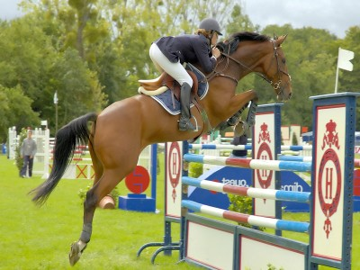
Research Question
What are the obstacles to physical activity in the MTF Transgender population ?
Notes:
To understand, to explore, to find out

Slide 6
Method
Qualitative Study
Population studied: MTF-TG people
Recruited from
  GP consultations, associations and web-forums
  Dec 2012 – October 2013
Framework-analysis
  constant comparison coding
Until saturation, double-coding
Notes:
Transcribed into text on microsoft word

Slide 7
Population (n=15)
Characteristics | Patients
Age | 54.13 years old ( 22-80)
Marital status | Single : 12; couple: 3
Nationality | South America: 5; USA: 1; Europe: 9
Sexual Reassignment | 6
Occupation | Retired: 3, In activity: 12
HIV status (positive) | 7/15
Interview duration | 62 minutes
Notes:
8 Nationalities
Conducted in French, English, Spanish
In the University, at home, in bars, calls
3 categories of obstacles
3 Brazil, 4 France, 2 Franco-italian, 2 colombia, 1 bolivia, 1 turckey, 1 USA, 1 argentina
Location: ACCEPTESS-T, PASST, bar, home, university

Slide 8
3 categories of obstacles
The Other
Society
Myself

Slide 9
“Myself”
Medical
HIV
Hormones
Depression
Bad Surgery Outcomes
Bad living condition
Notes:
Bad condition of living >”
Soi :
problèmes avec la tenue
virilisation/problématiques avec la virilisation
corps qui vieillit/modifications corporelles avec le temps
Les modifications corporelles, la chirugie esthétique :
la maladie qui freine : VIH, MTEV, HTA, dyslipidémie
La prise d’hormones
fatigue, paresse
dépression, émotivité
perte de la force musculaire
crainte, doute sur ce qu’on a le droit de faire ou pas
peur de se faire mal, de tomber malade
la fatigue
la dyspnée
dépression
Problèmes liés à l’image de soi :
ne pas supporter son corps
certaines parties du corps qu’on n’aime pas
ne pas se regarder nu
problèmes organisationnels : horaires incompatibles avec le travail
seule c’est difficile (motivation)
la confusion du genre qui empêche tout épanouissement dans le sport
se sentir différent
auto-critique
ça fait peur
doute intrinsèque de genre

Slide 10
Bad living conditions
“among our population, it may happen that we go and practice with empty stomach, because of precarity… we are able to go out with nothing in the stomach” (P5)
HIV
“So, I don’t know if it is because our first contact with the disease was very brutal but we live in the fear. Anytime we get something wrong we think “it’s the end, it’s coming back”, between the girls we way “the baby is waking up””(P5)
“and then, in the pool, with wet hair, I’m always scared to get sick, to get a cold. I have all the good reasons. I am very sensitive to the others staring at me. And AIDS… it just got even worse with it…because in plus I get the “she’s Trans”-look and “she is sick”. That a lot for one person you know…” (P1)

Slide 11
“Myself”
Depression:
« I’m kind of getting out of it right now but I got into a very severe depression. One year ago, my sister comited suicide so you know, I’m just not very into it right now ». (P1)
Hormones:
« Tears explosions that are coming out of the blue, I don’t no why. You’re down in the dumps for a few minutes and then it gets better. »
“… Hormones make me sick in my stomach” (E9)
Bad surgery outcomes
“So… it’s true, I had surgeries done and with esthetic surgeries and then when I play basketball, I needa be very careful, because I have breast implants and they might move sometime, get muscle tears. Once you have the surgeries done, you’re not disabled but… you have not what we call a “normal body”. Then I had silicone injected in my buttock –which I regret-, I’ve got fears, I needa be careful. When I don’t wear my support stocking, I’m a mess. I’ve got pain in my whole body, I have the feeling that everything is moving inside. It’s the same with violent sports like fighting sports. You can always get hit, it can be hard..” (P4)

Slide 12
“Myself”
Altered
Self-Perception
Muscles
Gender Confusion
Post-Surgery
Dysnormality
Weight

Slide 13
“Myself”
« I was scared that a physical activity made my muscles bigger » (P11)
« So we always wonder can I take off my clothes with this body, I have not had the surgery yet… » (P8)
« the bathing suite, you have to hide it, you have to find the right outfil, it has to hide the sex, so that no one notices the volume, the shape. It is very important. » (E7)

Slide 14
“The Other”
The Other
Violence
“Passing”
The Mirror Effect
Aging
Notes:
L’Autre :
Le regard de l’autre
Qui juge >> auto discrimination
Qui me démasque >> le passing
Qui me renvoit la confusion de mon genre >> la confusion du genre qui empêche tout épanouissement dans le sport
Qui doute de mon genre
L’épreuve du vestiaire : lieu symboliquement chargé ++
L’Autre violent
L’Autre fanstasmé, représentation, image en miroir de moi-même

Slide 15
The others
« You know, the other day, we went and practice with G. some guys arrived saying that they had booked the spot already… they asked us to leave. We said « sir, it’s a public area. There is no one else for the moment ». They said « get out of here you bitches » and they started to get into a fight with us. That was awful. » (P5)
« Yes, of course, if you don’t pass, you expose yourself to anything. This is the very big deal….can you imagine, if you don’t pass, people saying « it’s a man, what is this man doing in the ladies room ? ». yes, it’s normal. It’s a normal reaction. It may not me nice or anything but it’s understandable. The others should never expose themselves to this. This is so imprudent» (P11)

Slide 16
The others
« Me, I know I « pass » at 80% (…) but the other 20% it’s a very big deal. 20% may be nothing compared to the other Trans. Some « pass » at 50% only or others that are just transitionning and that is scary, I get that. But the pain, inside, it is the same. It’s not because it is only 20% that it feels good in the locker rooms. It’s definitely not my thing though. » (P4)
« My age, my aging. It’s enough already that I show my face, my hands. I’m not gonna show my body ! It’s enough » (E11)

Slide 17
Society
Society
Sports licence
Transphobia
« If I want to subscribe at the gym, I need a sports licence. If I want to compeet with other girls I need the licence that says Female. »(E09)

Slide 18
Discussion
Main results
  swimming = paradox
  Locker room
  Specific obstacles vs general obstacles
Emerging concepts
  Depression
  Passing = specific community concept
Gender identity vs sexual identity

Slide 19
Discussion
In General Practice
  Holistic approach
  sports as an excuse to talk about everything else
Solutions to overcome the barriers
  Practice in groups
  Sports supervisor
  Sports as a therapy
  No link with HIV

Slide 20
Strengths and Limitations
Innovative topic
Double-coding
The interviewer position (young doctor vs young doctor)
One “double” interview
No software

Slide 21
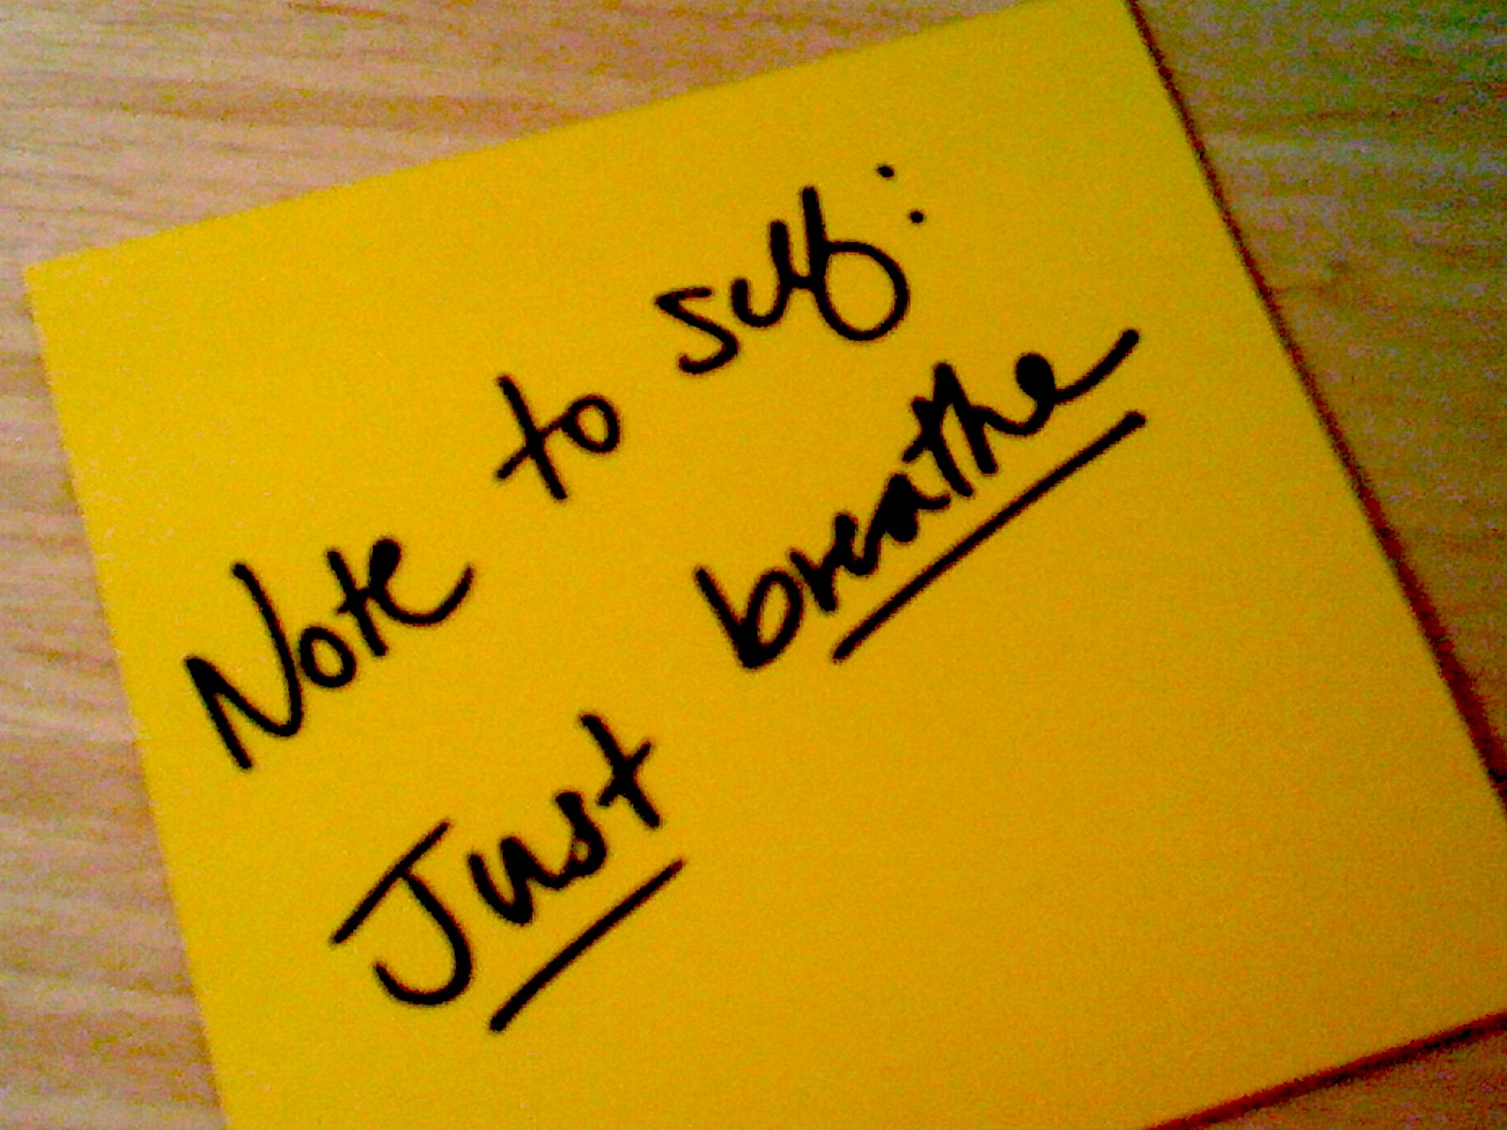
Please don’t eat me !

