Slide 1


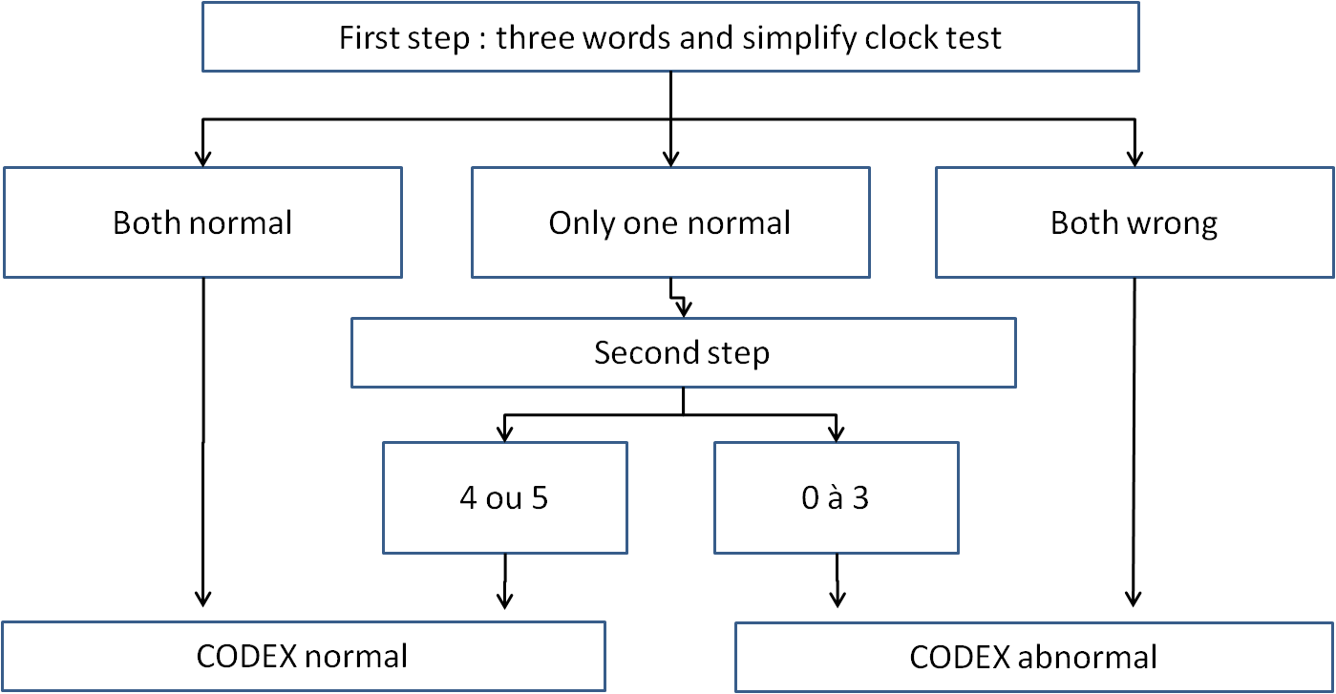
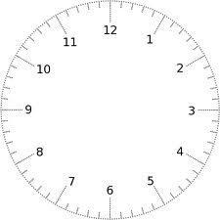



Diagnosis of dementia in primary care
CODEX TEST
A cross sectional propspective validation study of the cognitive disorders examination
I have memory troubles.
We’ll see that through the Codex test
The Codex test
Firts step
1-Mémorisation of 3 words : key, ball, lemon
2- a simplified clock-drawing test :
3-Repetition of the 3 words
Second step : if necessary
What is the name of the street, the name of the city, of the area, of the departement ?
What stage are we ?
Physicians codex results
Two indépendant experts
Psychologist’s cognitive evaluation :
on DSM IV criteria
Value of the test | Codex in primary care | Codex in memory center | MMS in memory center
Sensitivity | 87 | 92 | 91
Specificity | 72 | 85 | 70
Positive predictive value | 53 | 89 | 54
Negative predictive value | 94 | 86 | 93
21 GP’s have tested 139 patients, average age 82 years
Conclusion
The Codex confirm to be rapid and reliable test to detect dementia in primary care
Pr J.Belmin : Hopital Charles Foix, Ivry, France
Dr D.Baruch, Dr P.Zerr : Université Paris Diderot, département de médecine générale, Paris

