Slide 1
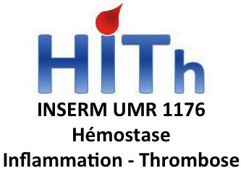



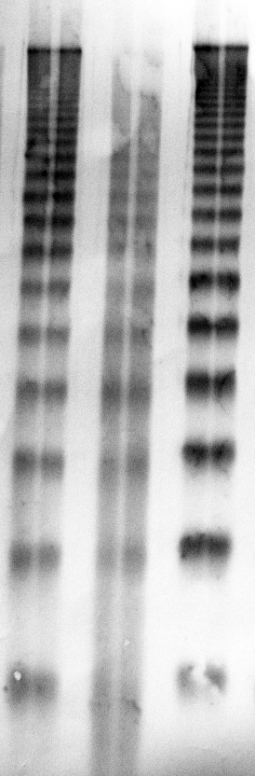
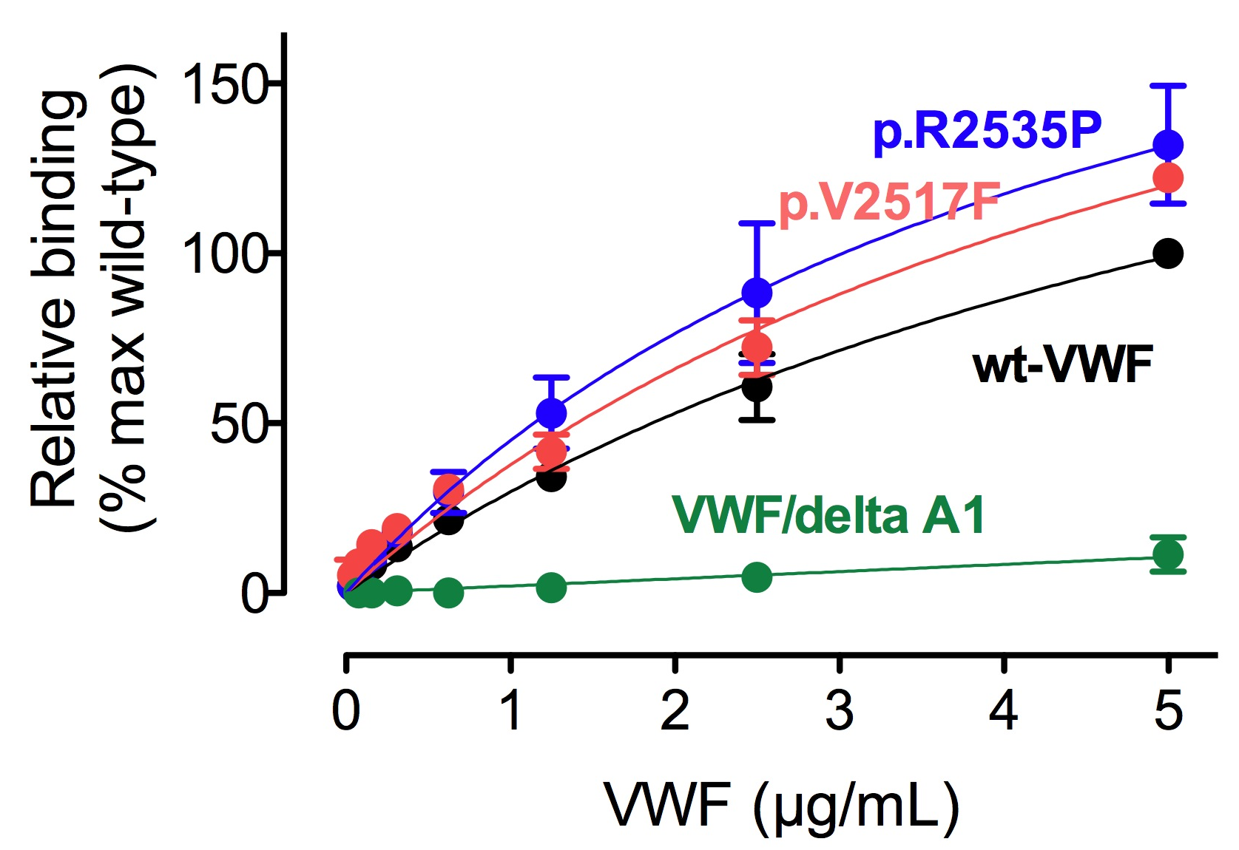
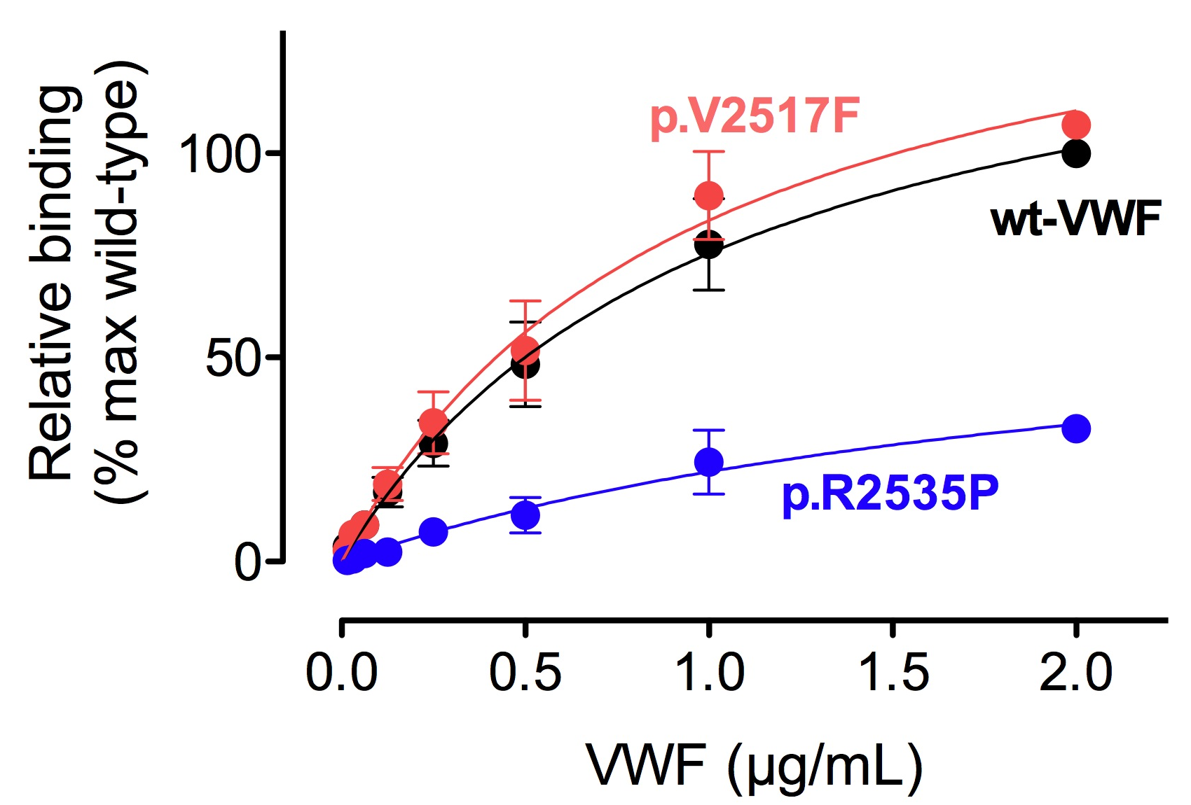
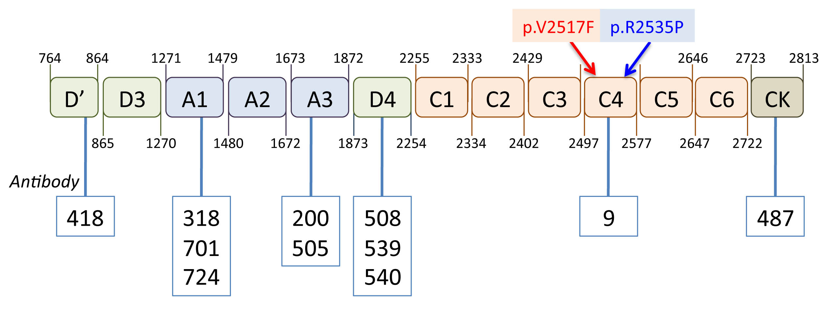
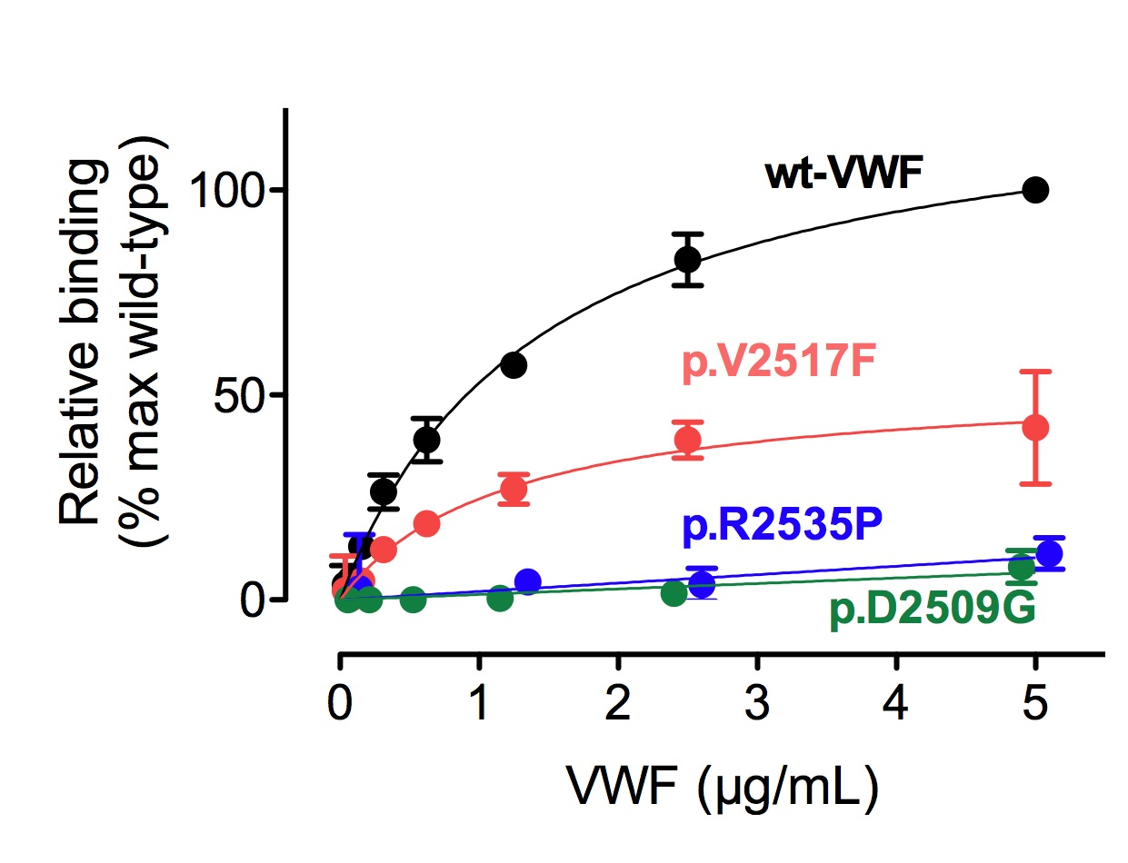
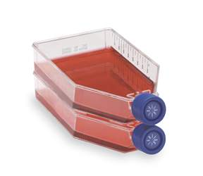
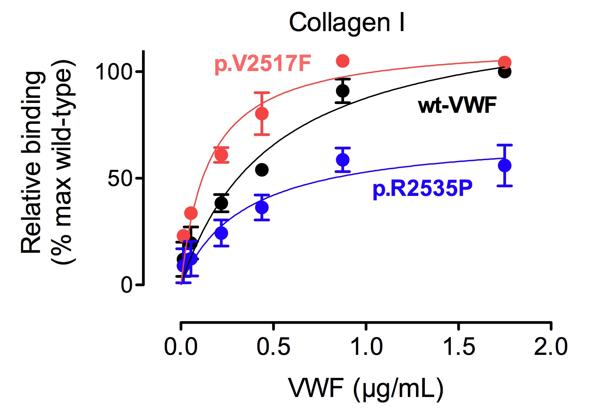
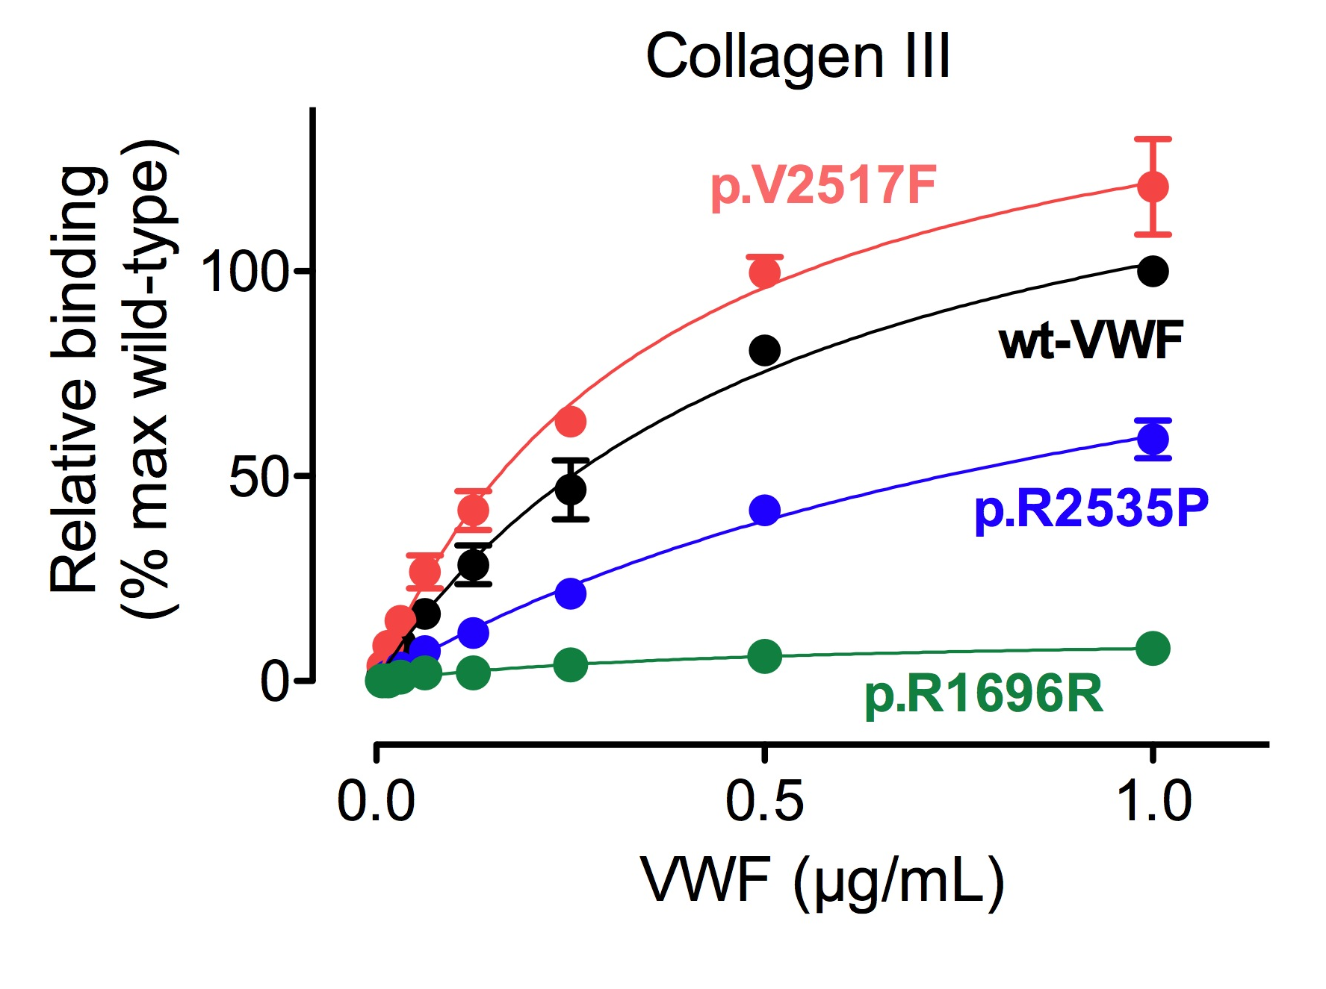
PO664-TUE
Functional study of two new mutations in the von Willebrand factor C4 domain
Paulette Legendre, Maxime Delrue, Pierre Boisseau*, Catherine Ternisien*, Edith Fressinaud, Agnès Veyradier**, Cécile V. Denis, Peter J. Lenting, Olivier D. Christophe
Inserm U.1176, Le Kremlin-Bicetre, France; *Laboratory of Molecular Genetics & Hematology, University Hospital Nantes, France; ** Laboratory of Hematology, Hôpital Lariboisière, Paris, France
Introduction
In the framework of the French National Reference Center for Von Willebrand Disease (VWD), two new mutations were identified: p.V2517F and p.R2535P, both of which are located in the recently defined C4 domain. The C4 domain of von Willebrand factor (VWF) contains the Arg-Gly-Asp motif that allows binding to integrin αIIbβ3.
Both patients display a mild bleeding phenotype and are classified as type 1 VWD.
Multimers & binding to antibodies
Binding to GpIbα & FVIII
1 2 3
GpIbα
Binding to GpIbα was compared to wt-VWF and VWF/deltaA1, which lacks GpIbα binding.
Binding to GpIbα was similar for both mutants in comparison to wt-VWF.
Culture medium of cells expressing wt-VWF (3), VWF/p.V2517F (1) or VWF/p.R2535P (2) was collected and analyzed via 2% SDS-agarose electrophoresis.
A normal multimeric pattern was obtained for wt-VWF and both mutants. Apparently, both mutations leave the capacity of VWF to form multimers unaffected.
Aim
To characterize binding of recombinant VWF proteins carrying these mutations to various ligands of VWF
FVIII
Binding to FVIII was compared to wt-VWF.
Whereas mutant p.V2517F was characterized by similar binding as wt-VWF, mutant p.R2535P was about 3-fold less efficient than wt-VWF.
Methods
Stable transfection of BHK-cells
Both mutants displayed normal binding to a series of antibodies recognizing different epitopes within the VWF protein, suggesting that the overall structure of the mutants is intact.
Binding to αIIbβ3
Binding to αIIbβ3 was compared to wt-VWF and VWF/p.D2509G, which lacks αIIbβ3 binding (RGD-mutant).
Binding to αIIbβ3 is reduced 2-fold for mutant p.V2517F and virtually absent for mutant p.R2535P.
Binding to collagen
Production of recombinant mutants
& concentration of culture medium
Analysis
Multimers
Binding to monoclonal antibodies
Collagen I & III
Factor VIII
GpIbα
αIIbβ3
Conclusion
Binding to collagen I and III was compared to wt-VWF and the VWF/p.R1696R mutant, which lacks collagen binding. Whereas mutant p.V2517F was characterized by a slightly enhanced collagen binding, mutant p.R2535P was about 2-fold less efficient than wt-VWF in binding to collagen I and III.
We have identified previously unrecognized VWF mutants with defects in binding to αIIbβ3 when the proteins were expressed as homozygous mutants. To our knowledge they represent the first patient-related mutations that modulate binding to this integrin. Interestingly, mutant p.R2535P has partially defective binding to collagen and FVIII.

