Slide 1
Use of 3 HIV testing methods in French primary care setting: ELISA Laboratory Screening versus 2 rapid finger-stick HIV tests with result under 5 minutes (INSTI) and up to 30 minutes (VIKIA)
Daiana Papadima ¹,², Raphaël Gauthier ²,³^{,4}, François Prévoteau du Clary ^{2,5}, Jean-Pierre Aubert ^{2,3,4}, Stéphane Bouée ^{2,6}, Guillaume Conort ^{2,7}, Jean-Michel Livrozet ^{2,8}, Jean-Michel Peter ^{2,12},
Olivier Taulera ^{2,9}, Alain Wajsbrot ^{2,10}, Catherine Majerholc ^{2,3,4,11}
¹ Département de Médecine Générale, Université Louis Pasteur Strasbourg, France
² Groupe d’études et recherché ville-hôpital : 75 rue du Ruisseau, Paris, France
³ Univ Paris Diderot, Sorbonne Paris Cité, Dept Med Gen, F-75018 Paris, France
⁴ EA Recherche Clinique Coordonnée Ville-Hôpital, Méthodologies et Société (REMES), F-75018 Paris, France
⁵ Hôpital La Grave, Hôpitaux de Toulouse, France
⁶ Cemka Eval, 43 Boulevard du Maréchal Joffre, 92340 Bourg-la-Reine, France
⁷ Département de Médecine Générale, Université de Bordeaux, France
⁸ Service des maladies infectieuses et tropicales, Hôpital Edouard Herriot, Lyon, France
⁹ Hôpital Saint Louis, Paris, France
¹⁰ Médecine Générale, Hôpital d’Avignon, France
¹¹ Service de médecine interne, Hôpital Foch, Suresnes, France
¹² Groupe Hospitalier Mulhouse Sud-Alsace, France

Slide 2
Background
2009: French national guidelines recommended:
  Widespread routine HIV screening and regular targeted screening in group risks and/or depending on circumstances.
  Promotion of rapid point of care HIV tests (RHT) to expand HIV screening .
In 2014: reserved results: low increase in HIV tests, stability of hidden HIV epidemics (around 29000 people unaware being HIV+):
  Mass screening strategy based on RHT in emergency room showed low feasibility¹;
  The missed opportunities study² showed GPs could have targeted screening on risk groups and clinical signs.
  The national report experts’ group³ and the GPs National Council⁴ insisted on risk factors based screening
RHT feasibility in French general practice: little amount of data.
  Good acceptability and limited feasibility due to time restriction, technical difficulties and staff training⁵.
  Efficient strategy in Guyane (highest HIV prevalence in France) with financial support from the social security⁶.
The joint screening offer of HIV, HBV and HVC study showed that after appropriate training, motivated GPs improuve their testing rate, even during a short period and specially among risk groups⁷.
New study: DEPIVIH 2. Besides VIKIA RHT, we introduced an immediate answer RHT (INSTI) and left the possibility of using Elisa blood tests.
Simultaniously offering GPs 3 screening tools from which to choose could help finding the best suited HIV screening strategy for general practice and hence diminish the hidden HIV epidemics.
¹ CASALINO E, BERNOT B, BOUCHAUD O, et al. Twelve months of routine HIV screening in 6 emergency departments in the Paris area : results from the ANRS URDEP study. PLoS One, 2012, vol.7, n°10, 8 p.
² Karen Champenois Opportunités manquées de dépistage du VIH chez des patients nouvellement diagnostiqués en France EtudeANRS. Opportunités Online:www.anrs.fr/.../14%20%20%20Karine%20Champenois_20120504.pdf
³ Professeur Philippe Morlat, CNS et ANRS. Prise en charge médicale des personnes vivant avec le VIH. Actualisation 2014 du rapport 2013 112 p. Online: http://www.sante.gouv.fr/IMG/pdf/experts-vih_actualisations2014.pdf.
⁴ Dépistage de l’infection par le VIH en médecine générale . Multiplier les propositions de test et privilégier l’entretien orienté. Henri Partouche et Vincent Renard. CNGE. Présentation orale 17 diapositives; Online: www.anrs.fr
⁵ GAUTHIER R, LIVROZET JM, PREVOTEAU DU CLARY F, et al. Feasibility and acceptability of rapid HIV test screening (DEPIVIH) by French family physicians. Médecine et maladies infectieuses, 2012, vol.42, n°11, pp. 553-560
⁶JOLIVET A, SANGARE I, DIMANCHE S, et al. Les tests rapides d’orientation diagnostiques (TROD) du VIH par les médecins libéraux : bilan d’un an d’expérimentation en Guyane. Bulletin de veille sanitaire Antibes-Guyane, 2012, n°10, pp. 18-20
⁷ Catherine Fagard et al. Feasibility of joint screening for HIV, HBV and HCV by general practitioners in two French counties, 2012. Bulletin épidémiologique hebdomadaire N° 21-22 - 8 juillet 2014. pp 395-400

Slide 3
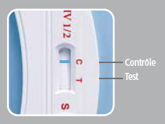
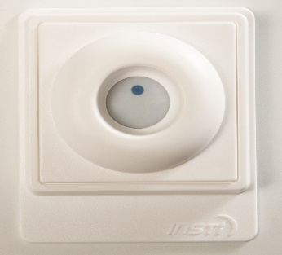
Methods
National prospective interventional study led in French GPs offices between December 2013 and December 2014
Primary outcome: to assess the use of 3 methods in French GPs current HIV screening practice:
  ELISA test prescription,
  immediate answer RHT INSTI (Nephrotek),
  or 30 mn delayed answer RHT VIKIA (BioMérieux).
Adult patients over 18 of unknown HIV status visiting their physician were eligible for study.
HIV testing was performed following spontaneous patient request or physician recommendation on routine or targeted basis.
Secondary endpoints:
Screening rate of population with unknown HIV status consulting during the study period,
Screening circumstances and reasons for the chosen screening method,
Investigators satisfaction regarding RHT and encountered problems.
VIKIA
INSTI

Slide 4
Results: use of each screening method
981 HIV tests were performed by 43 GPs during a mean period of 7 months, leading to a screening rate of 1% of the attending adult population.
Mainly Elisa blood test and the immediate answer point of care test – INSTI.
Mean use by GP: 23 tests (18 Elisa tests and 5 RHT)

Slide 5
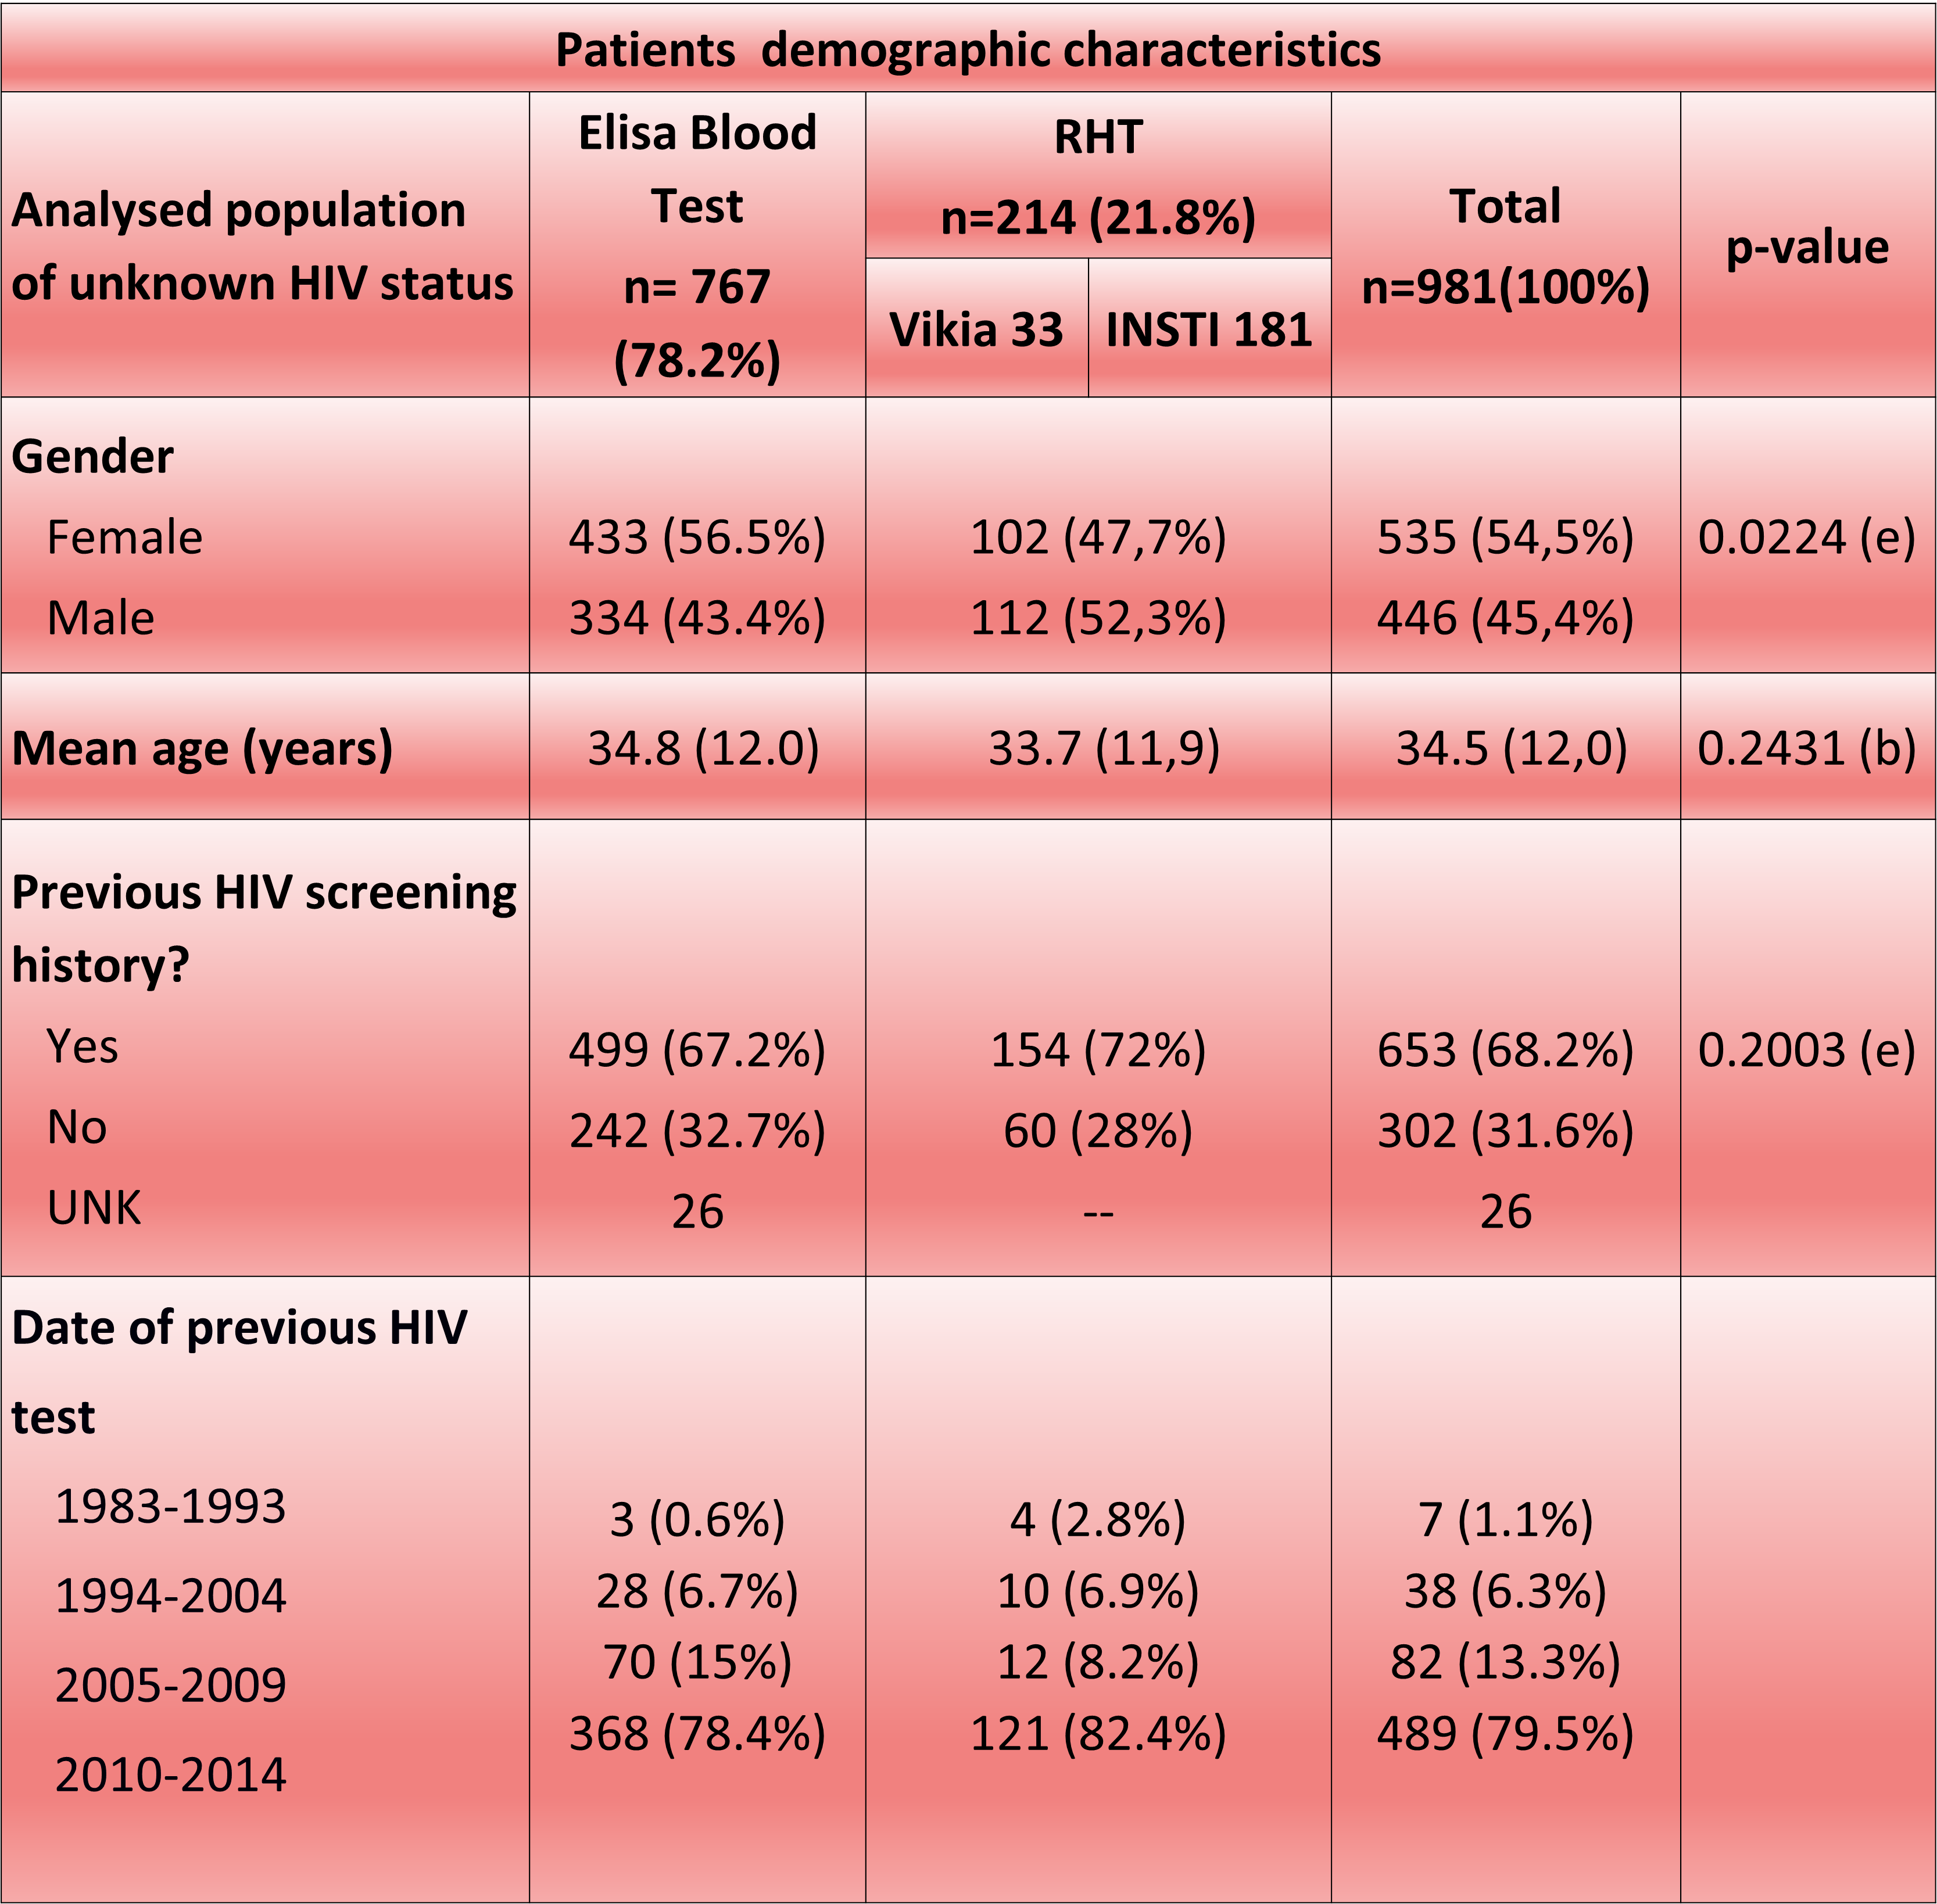
Results : patients data
Population:
  mean age 34.5 years,
  mostly women (54.5%)
  68.2% already had a previous HIV negative test, among whom 78.2% within the last 3 years.
No significant differences between the Elisa Group and the RHT group in terms of age, sexe and HIV screening history.
UNK – unknown, (b) Student Test , (e) CHI2 Test

Slide 6
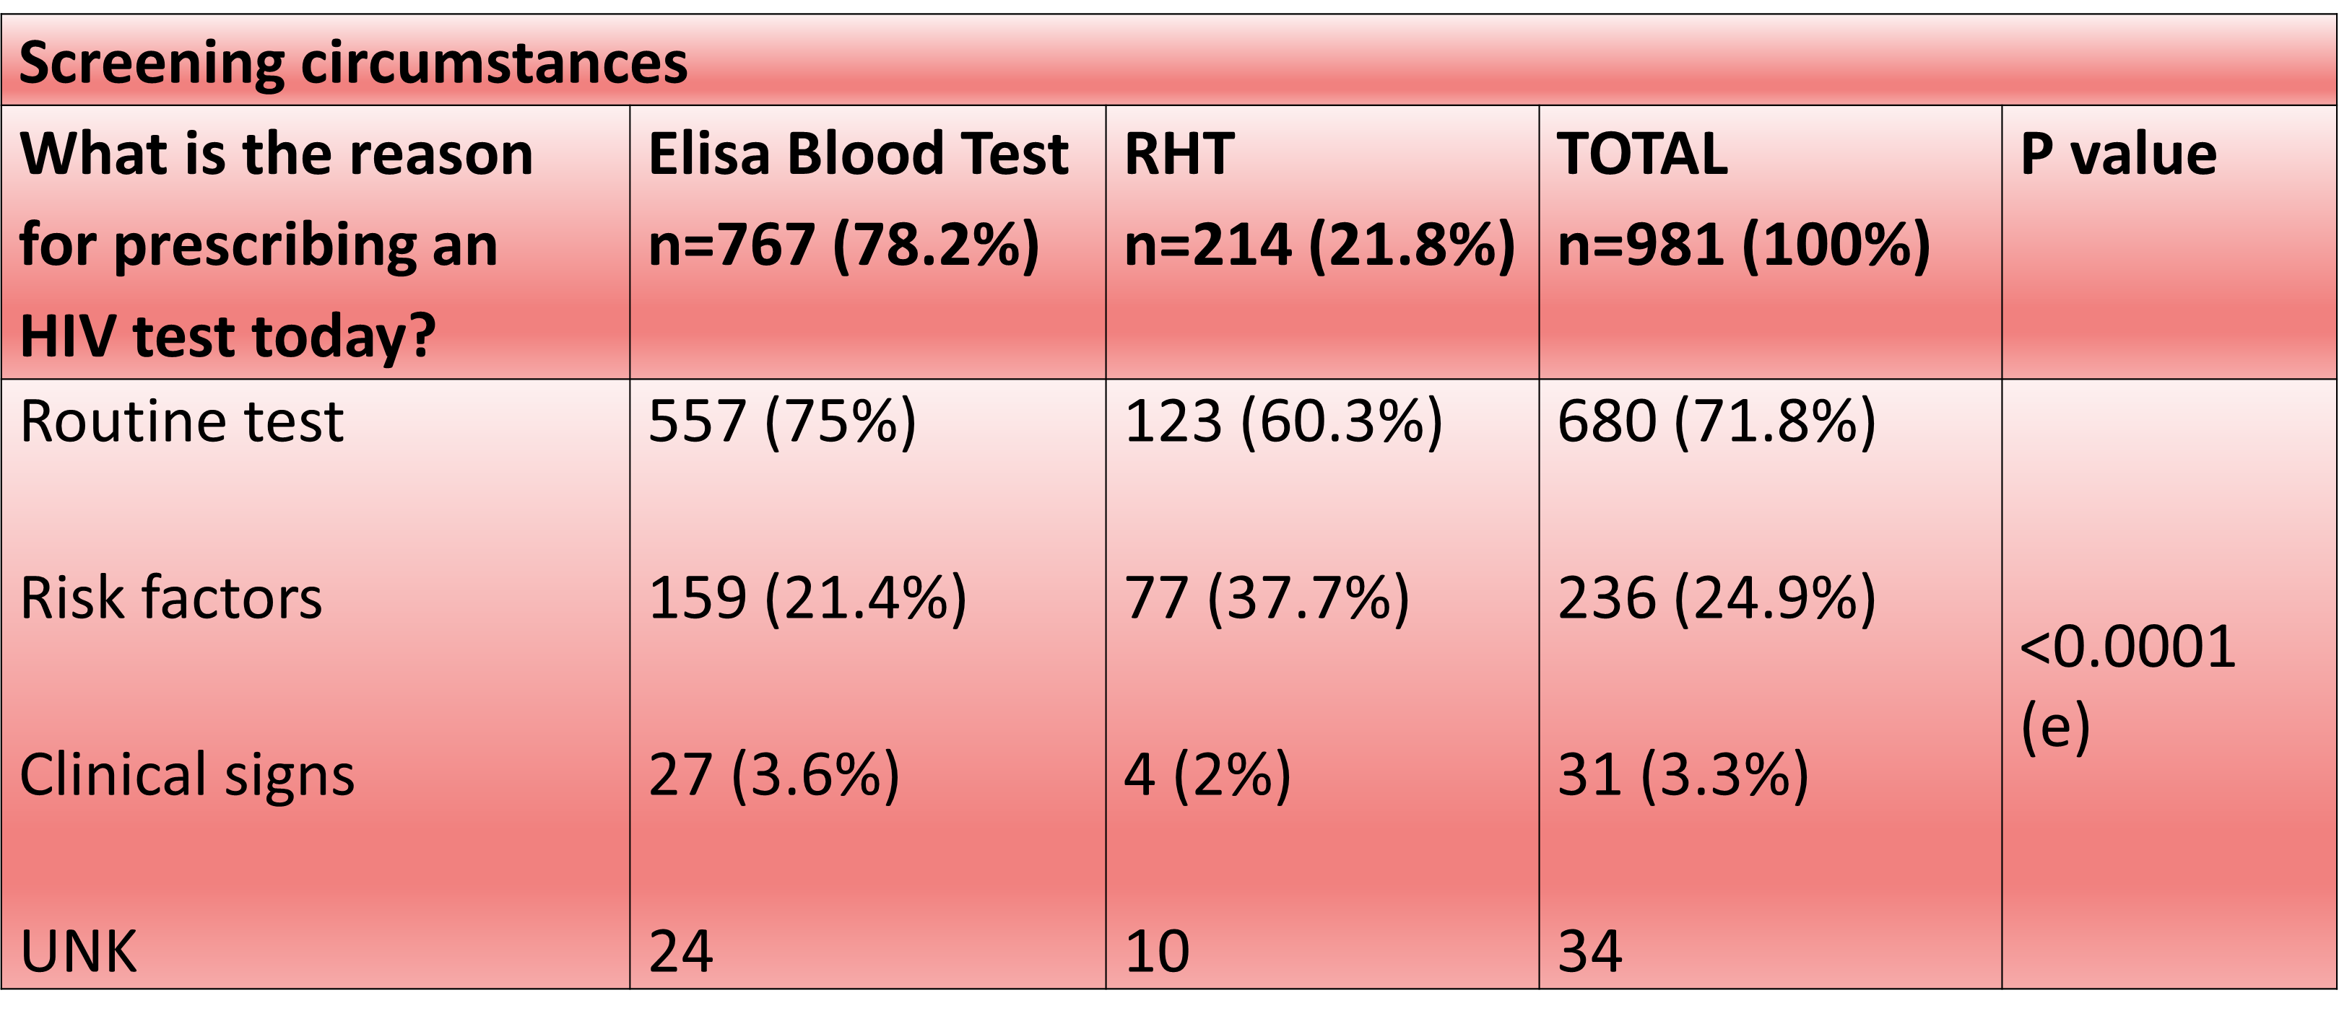
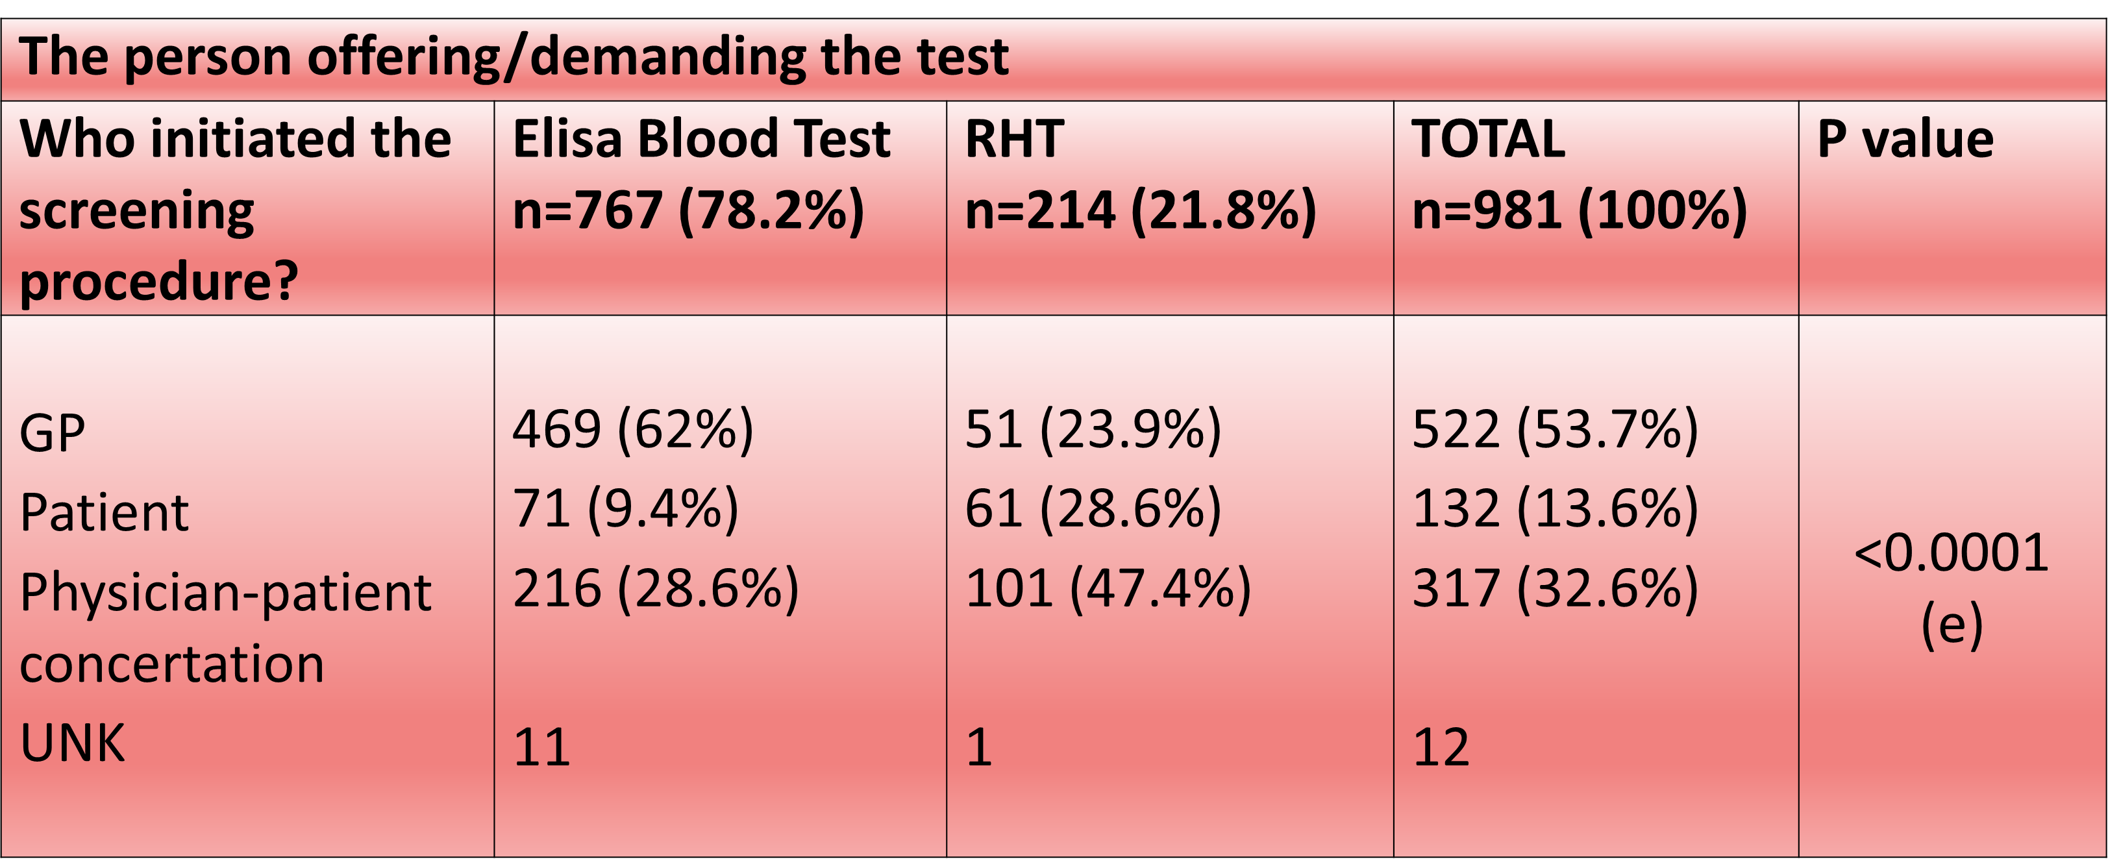
Results: screening circumstances
UKN – unknown; (e) - CHI2 test
UNK – unknown; (e) - CHI2 test
Reasons for choosing Elisa blood test/RHT :
<3 months HIV exposure: 19% of Elisa blood tests and 25% of RHT;
HIV primary infection+HIV clinical signs: 2.9% of Elisa blood tests and RHT;
Opportunity to combine blood tests: 85.8% of Elisa tests;
Opportunity of performing a RHT: 68.4% of RHT;
Rapidity of test result :43.4% of RHT;
Certainty of having the test done and the result delivered: 15.1% of RHT;
Fear of venous blood sampling: 11.8% of RHT.

Slide 7
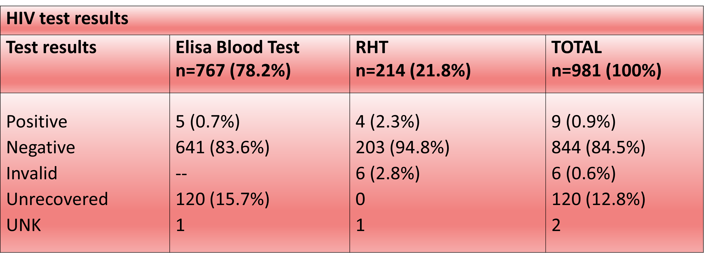
HIV Test Results
With potentially HIV clinical signs (4/9) and comorbidities (3/9, 2 with chronic HBV and one with chronic HCV).
The 3 patients with medical history and regular follow up for chronic hepatitis were diagnosed by RHT.
All confirmed and linked to care.
NDHI were made by 5 GPs, in cities of Paris, Toulouse, Lyon and Marseille.
  4 GPs have part time clinic duty in the follow up of patients suffering from chronic viral infections,
  Mean number of patients HIV+/month during the study period:78,
  Screening rate: 3% (3 times higher than the average study screening rate).
UNK – unknown
9 newly diagnosed HIV infection (NDHI):
  7 men and 2 women,
  mean age 37,
  mainly after targeted screening,
  after GPs offer or concertation,
  4 MSM and 5 migrants,
  2/3 with previous screening history.

Slide 8
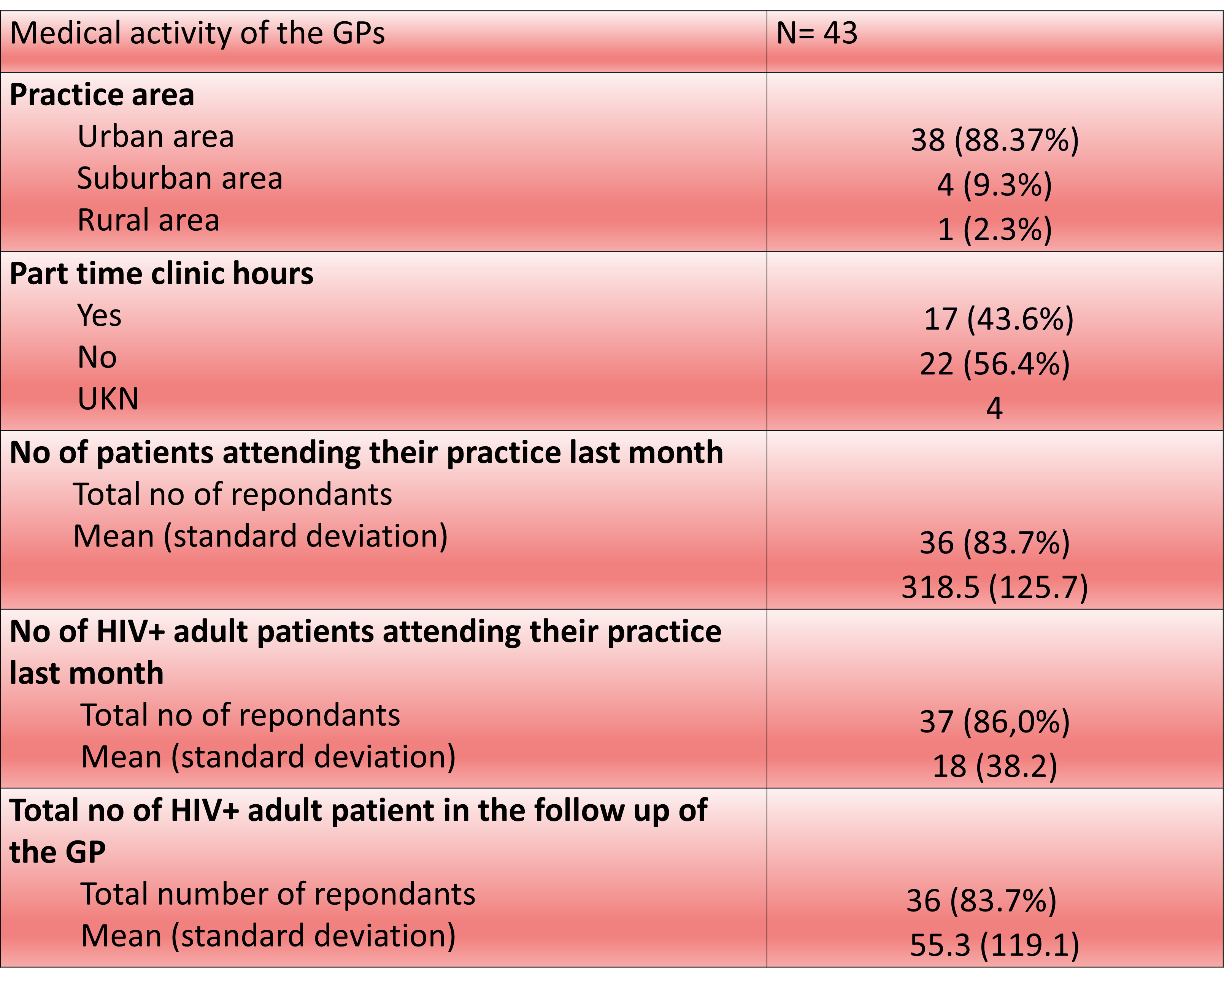
GPs characteristics
GPs satisfaction and incoveniencies
43 GPs, mean age 46 yrs, 48.8% women, one third practising since 2009
GPs satisfaction regarding RHT
90.9% of GPs were globally satisfied with the RHT (97% by the laps of time used for INSTI and 38.5% of VIKIA);
8 GPs/10 would continue using INSTI point of care test in their current practice.
Principal problems:
Technical difficulties for 13.9% of RHT mainly related to blood sampling.
HIV test announce:
  same difficulty with Elisa or RHT for 61.3%,
  19,4% express more difficulty with RHT.
15.7% of the prescribed Elisa blood tests were not done by the patient.
UKN – unknown

Slide 9
Conclusion
Giving GPs several HIV testing methods led to a significant screening activity .
Elisa blood test was the most frequently chosen screening method, mainly by physicians, in order to regroup with several blood analysis.
RHT were mainly on patient demand or after concertation.
RHT INSTI was preferred due to its rapid result delivery.
Most of the tests were routine screening procedures.
28.2% were targeted:
- mainly on HIV risk factors;
- in lesser degree on HIV clinical signs.
The significant part of the undone blood tests emphasises RHT point of care as an alternative screening tool.
9 NDHI were made (0.9% of 981 tests):
  After targeted screening: MSM and migrants;
  By 5 GPs, among whom, 4 frequently confronted with HIV epidemics;
  By RHT as well as Elisa blood test.
One third of the GPs are more sensitive to HIV screening:
  Additional medical activity in HIV + follow up ;
  Recent office practice after 2009 (release of the current guidelines by National Health Administation) , more up to date.
RHT used by GPs working in high HIV prevalence areas:
    allow screening complementary to the classic Elisa blood test;
    an interesting screening tool expanding the HIV test offer;

Slide 10
Acknowledgements to all participants:
Dr Catrice M
Dr Taulera O
Dr Golfier JB
Dr. Gauffier N
Dr. Kokougan C
Dr. Di Pumpo A
Dr. Provost AG
Dr. Salaun A
Dr. Lhuillier L
Dr. Seif A
Dr Bacle F
Dr. Nougairede M
Dr. Cordonnier
Dr. Mourier
Dr. Pillon N
Dr. Lalande M
Dr. Leymarie
Dr. Melchior Y
Dr. Majerholc C
Dr. Catusse
Dr Philibert
Dr. Simon Cohen A
Dr. Cadart
Dr Wajbrot A
Dr Regard P
Dr Zanutini C
Dr Goudilliere B
Dr. Haag H
Dr. Pinar M
Dr. Chauveau M
Dr. Palaz Nafnef M
Dr. Adam M
Dr. Pariente K
Dr. Prevoteau F
Dr Wieser
Dr Pellissier
Dr. Willemain I
Dr Leveque
Dr Plaum
Dr. Naessens M
Dr Gueripel V
Dr Godinot
Dr Chiarello

