Slide 1



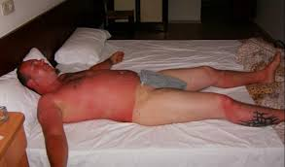


EGPRN Tel Aviv. May 2016
How To Appreciate Physician Well-being ?
Right (*)
Wrong
Care, Education, Research
Knowledge, Experiences, Values
Burn out, Medical Errors, Physician Illnesses
Quality of Care, Patient Safety, Physician wellbeing
Analysis, Management, Involvement
Pr Eric GALAM eric.galam@univ-paris-diderot.fr
EAPH Conference 24th and 25th Avril 2017- Paris, France
(*) Galam Eric (2012) L’erreur médicale, le burnout et le soignant. Paris Springer

