Slide 1

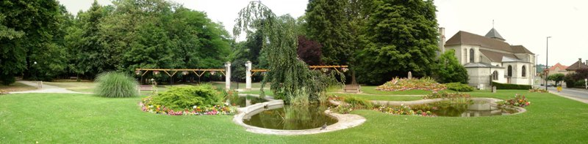
Helpline between Ambulatory Medicine and Hospital Experts: efficient patient pathway avoiding the Emergency Department Flux Management Bottleneck
Dominique Le Moult¹, Gérard Nguyen¹, Lise El Hajj²
¹Cabinet médical Marcel Monny Lobé, Soisy sous Montmorency, France
²Maladies Infectieuses et Tropicales, Hôpital Simone Veil, Eaubonne, France
Contact: dlemoult2002@yahoo.fr
Notes:
Soisy is a small town, about 15 km North West of Paris
Depending of a rural hospital xx beds, in population catchment area of XXX population
Most specialities available
Ratio of GPs in the district:

Slide 2
Conflict of Interest Declaration
None
Notes:
Except being final user of the described helpline.

Slide 3
Introduction
Management of patient flux at Hospital Emergency Unit remains a challenge,
In Primary care, How to address the right patient to the right hospital expert, by-passing the emergency waiting queue is the key issue in some clinical situations,
Notes:
Number of patients per day at Emergency Department:
Patients consulting out of hours at Emergency Dep, without urgent need, for personal convenience.
Limited ressources, that have been redesigned already to cope with influx.
Care provided for free at hospital.

Slide 4
Emergency in primary care
In France
In Primary Care, GPs have different triage solutions for critical situations:
  Via the Territorial Emergency Hotline: « 15 » or « 112 »
    With the possibility to discuss with the senior « regulator » MD ,
    Resulting in the mean of transportation to hospital:
      Mobile Emergency unit (SMUR or SAMU)
      Ambulance
  Direct addressing to the Hospital Emergency Department
  Direct addressing to the Specialised Hospital Department
Notes:
#15 from landline numbers, #112 for mobile phones.
Some patients get medical advice out of hours with GPs at #15
More and more patients are referred to ED without prior GP ’s screening.
Direct access to hospital departments requires prior consent of senior officer in that dep.

Slide 5
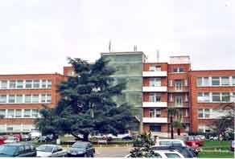
Specific organisation
Since 2009, our district hospital set up a specific organisation called « direct access to specialist senior MD, referent for primary care »
Almost each specialist department has a referent MD with a direct mobile phone line, on call from 9 am to 5 pm
An update Diary , provided by the Hospital, with all referent direct mobile lines is available for all GPs
Notes:
Mobile phone numbers are not divulgated to the public: GPs use only
Some missing departments: psychiatry, ophtalmology, gynaecology-obstaetrics,
Not available out of hours
Has been updated in 2010-2011

Slide 6
Clinical Case
  Jean Pierre C, 78 y.o. male called for a home visit.
  He had a history of fever (38°C) during 3 weeks with an inflammatory syndrome (CRP= 99), an hepatitis with cytolysis,
    GGT 117, ASAT 42, ALAT 68
    HBS Ag -, antiHBC +, antiHBS +
    antiVHA: Ig A and IgM +
  Liver- and spleno-megaly were discovered by US Echography
  2 days before, antibiotics had been started for a suspected pneumopathy.
At home he presented:
  A persistent fever, 38,5°C and new symptoms:
    A left shoulder pain without a history of trauma
    Dizziness
    Short breathing
Notes:
Initially referred to gastro-enterologist in town.
Reviewed at home, very unwell: that is how I decided to call hospital specialist for infectious diseases, who accepted to see the patient the following day.

Slide 7
Clinical Case
The helpline with the head of infectious diseases unit allowed an immedidate consultation and then direct admission to Infectious Diseases Department .
Biology results were similar to ambulatory ones, but LDH 2247
Diagnosis hypothesis and explorations ?
Notes:
At hospital, initial treatment for suspected pneumopathy on clinical grounds with bi-antibiotherapy (rocephin + tavanic)
Thoraco abdominal CT scan, as following

Slide 8
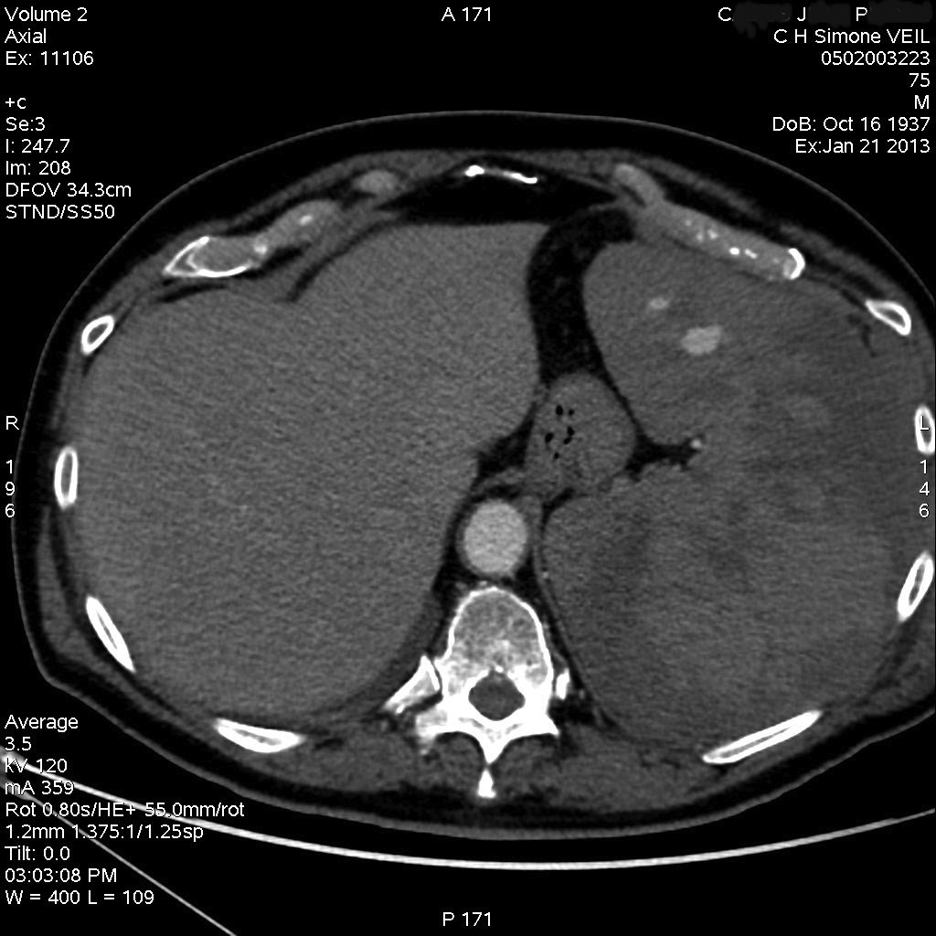
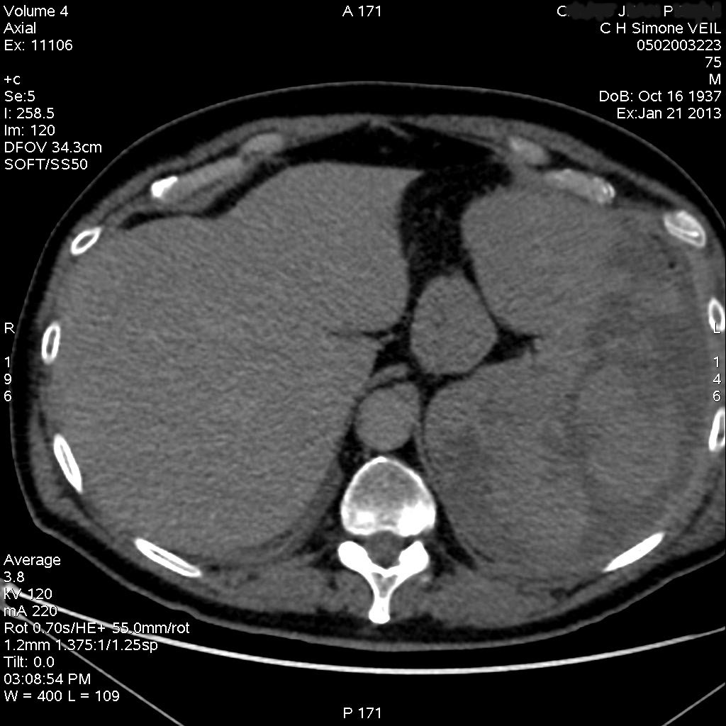
CT Scan

Slide 9
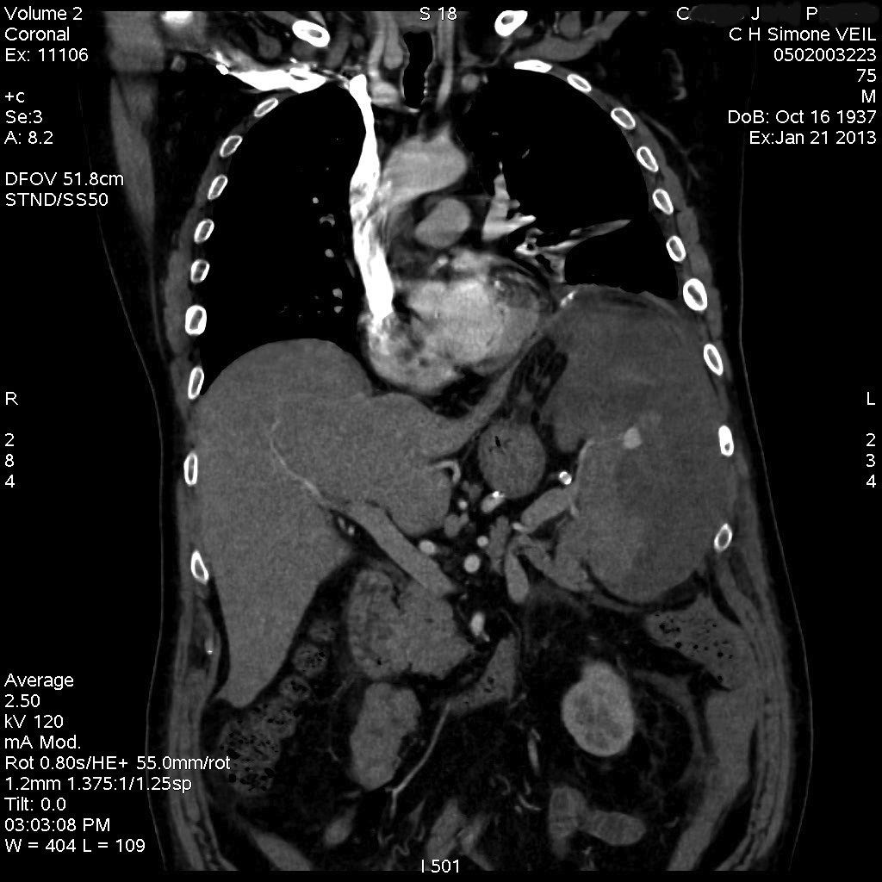
CT Scan

Slide 10
Clinical case discussion
The patient underwent surgery for a spontaneous spleen rupture
Histology revealed Giant Cells B Lymphoma
After staging, the patient underwent appropriate chemotherapy protocol,

Slide 11
Spontaneous spleen rupture
Spontaneous or Atraumatic Spleen Rupture (ASR)
Rare: 30 newly reported cases/year
Sex ratio: 2/1 male
Age: median 46 , range (18-86)
Aetiology
  Neoplastic 16.4%
  Infectious 14.8%
  Inflammatory 10.9%
P. Renzulli, A. Hostettler, A. M. Schoepfer, B. Gloor and D. Candinas. Systematic review of atraumatic splenic rupture British Journal of Surgery 2009; 96: 1114–1121

Slide 12
Conclusion
The senior MD in this situation had the opportunity to set up a pluri-disciplinary decision for surgery and chemotherapy,
A lack of chance could be related to the addressing pathways to hospital,
Rare , acute atypic clinical situations seen in Primary Care need direct co-operation with senior hospital experts,
A direct co-operation with an available specific expert needs a care organisation,
The Gate Keeper GP’s role provide added value, while working directly with on-demand hospital specialits
Our organisation with the « direct specialist referent » devoted to GPs via GSM line provides the optimal efficient management of difficult conditions seen in primary care

